Slide 1
OpenAPI 3.0
Certification Training

Slide 2

Chris Riley
Director of Solutions Architecture, cPrime, Inc.
Training, consulting, reseller of Smartbear
25 years industry experience, 20 years IT
Speaker at QCon, SOA Symposium and User Groups / Meetups
Swagger Champion

Slide 3
cPrime, Inc
Who is cPrime?
Agile, Atlassian and DevOps Consultancy
Agile, Atlassian, DevOps and OpenAPI Training
Outsourcing
150+ personnel based across US, parent 20K+
OpenAPI 3.0 Certification Training Training

Slide 4
History
1
How did we get here?
OpenAPI 3.0 Certification Training

Slide 5
History
Linux Foundation hosted
Started with Swagger 2.0 being donated by Smartbear
Standard renamed OpenAPI 2.0
OpenAPI 3.0 released in 7/2017
OpenAPI 3.0 Certification Training Training

Slide 6
What is it?
Standard which helps one easily define and share a REST API
API Documentation standard
OpenAPI 3.0 Certification Training Training

Slide 7
Who should know this ?
Everyone who participates in API initiatives:
e.g. directors, managers, architects, developers, devops, qa, business analysts, partners, operations
OpenAPI 3.0 Certification Training Training

Slide 8
What is REST?
REST is all around us
Representational State Transfer, Roy Fielding Dissertation
Uses common internet technologies to move information
OpenAPI 3.0 Certification Training Training

Slide 9
Underpinnings
HTTP (Hypertext Transfer Protocol) - How to communicate
URI (Uniform Resource Identifier) - What and where is it
HTML (Hyper-text Markup Language) - What am I sharing
OpenAPI 3.0 Certification Training Training

Slide 10

What is Service?
Interface
Logic
Data

Slide 11
Interface examples
standardized definition of what functionality is available
WSDL/XSD
IDL
WADL
RAML
OpenAPI/JSON Schema
OpenAPI 3.0 Certification Training Training

Slide 12
Logic
up to you, pick your poison :-)
OpenAPI supports numerous generated servers and clients
JAX-RS, Python, PHP etc.
OpenAPI/JSON Schema
OpenAPI 3.0 Certification Training Training

Slide 13
Data
data can be stored in SQL, NoSQL, Object Stores etc.
most challenging piece of API design
leverage data standards such as JSON Schema, XML Schema
OpenAPI 3.0 Certification Training Training

Slide 14
REST Primer
1
Let's discuss the fundamentals
OpenAPI 3.0 Certification Training

Slide 15
HTTP, URI, HTML
HTTP: Verbs, Headers, Status Codes
URI: URL, query parameters, path parameters
HTML: Links
OpenAPI 3.0 Certification Training Training

Slide 16
HTTP Verbs
GET - idempotent, access current resource state (READ)
POST - create instance resource (CREATE)
PUT - create resource if it doesn’t exist, otherwise update entire state (CREATE/UPDATE)
PATCH - update portion of resource state (SELECTIVE UPDATE)
DELETE - delete resource (DELETE)
OPTIONS - provide details of resource supported methods (WHAT DO YOU DO?)
HEAD - same as GET with no body (JUST CHECKING YOU ARE RUNNING)
OpenAPI 3.0 Certification Training Training

Slide 17
HTTP Headers
Standard headers defined by w3c
https://www.w3.org/Protocols/rfc2616/rfc2616-sec14.html
Authorization : Bearer dh142381htp10231
OpenAPI 3.0 Certification Training Training

Slide 18
HTTP Status Codes
1XX - Informational, 100 Continue
2XX - Client Success, 200 OK, 201 Created, 204 No Content
3XX - Redirection, 301 Moved Permanently, 302 Found
4XX - Client Errors, 400 Bad Request, 401 Not Authorized, 404 Not Found
5XX - Server Errors, 500 Internal Server Error, 503 Unavailable
OpenAPI 3.0 Certification Training Training

Slide 19
URI
http://hosts/version/path
http://api.twitter.com/1.1/search
OpenAPI 3.0 Certification Training Training

Slide 20
Parameters
Path - http://api.twitter.com/tweets/191920
Query - http://www.google.com?name=Chris%20Riley
Cookie - Cookie: debug=0; csrftoken=BUSe35dohU3O1MZvDCUOJ
Header - apikey = 41231510291
OpenAPI 3.0 Certification Training Training

Slide 21
MIME Types
Multi-purpose Internet Mail Extensions
Standard that helps communicate data to be exchanged
text/plain, application/json, application/xml, image/jpg
http://www.iana.org/assignments/media-types/media-types.xhtml
OpenAPI 3.0 Certification Training Training

Slide 22
Links
HTTP/1.1 200 OK
{
"name": "Alice",
"links": [ {
"rel": "self",
"href": "http://localhost:8080/customer/1"
} ]
}
OpenAPI 3.0 Certification Training Training

Slide 23
Callbacks
Subscribe for Event
Provider
Consumer
Invoke endpoint
on Consumer sometime later
OpenAPI 3.0 Certification Training Training

Slide 24
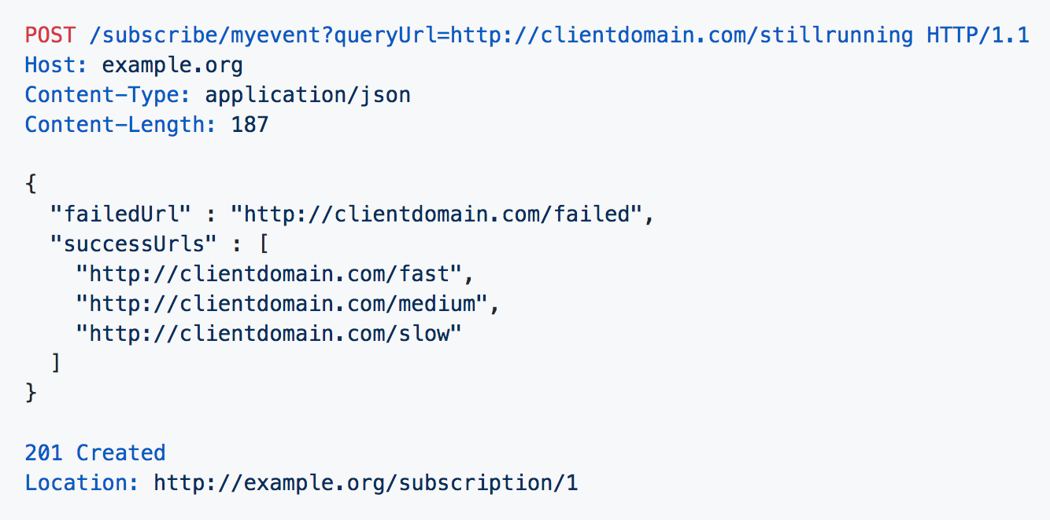
Callbacks
OpenAPI 3.0 Certification Training Training

Slide 25
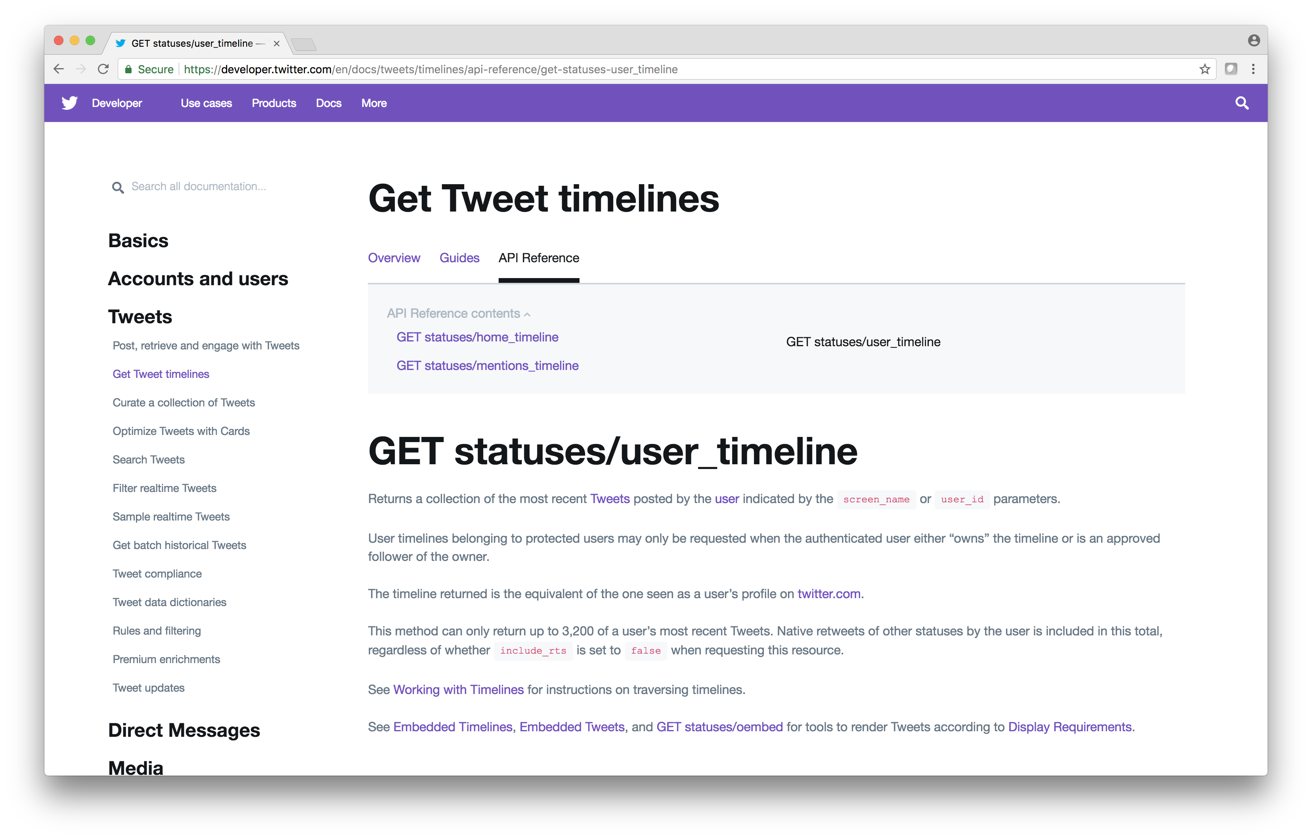
REST Example
Twitter API
OpenAPI 3.0 Certification Training Training

Slide 26
GET Statuses User Timeline
Twitter API Request
Documentation URL | https://developer.twitter.com/en/docs/tweets/timelines/api-reference/get-statuses-user_timeline
HTTP Verb | GET
URI | https://api.twitter.com/1.1/statuses/user_timeline.json?screen_name=twitterapi&count=2
Response MIME Type | JSON
Requires Authentication | Yes, Twitter’s OAuth 1.0a implementation
OpenAPI 3.0 Certification Training Training

Slide 27
GET Statuses User Timeline
Twitter API Response
Response MIME Type | application/json
HTTP Response Code | 200, not identified in documentation
Response | [ { "created_at": "Thu Apr 06 15:28:43 +0000 2017", "id": 850007368138018817, "id_str": "850007368138018817", "text": "RT @TwitterDev: 1/ Today we’re sharing our vision for the future of the Twitter API platform!nhttps://t.co/XweGngmxlP", "truncated": false, "entities": { "hashtags": [], "symbols": [], "user_mentions": [ { "screen_name": "TwitterDev", "name": "TwitterDev", "id": 2244994945, "id_str": "2244994945", "indices": [ 3, 14……..]
OpenAPI 3.0.0 Certification Training

Slide 28
OpenAPI / Example Overview
1
API Documentation Standard
OpenAPI 3.0 Certification Training

Slide 29
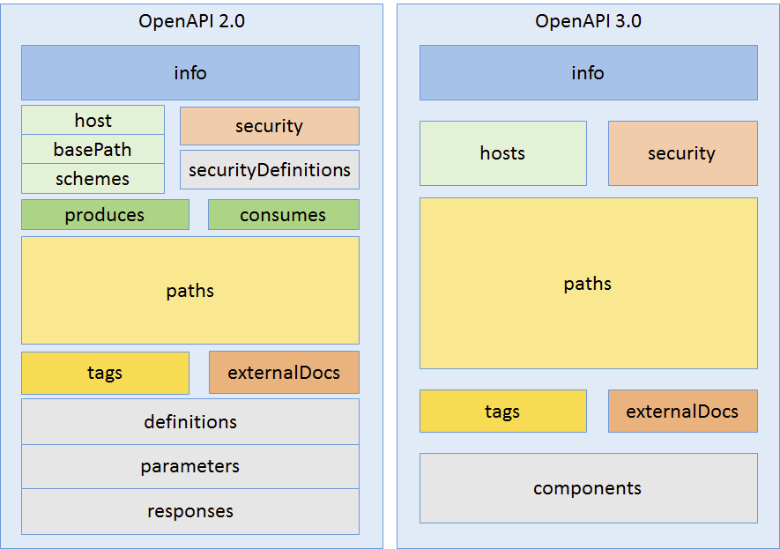
Structure
https://www.openapis.org/news/blogs/2016/10/tdc-structural-improvements-explaining-30-spec-part-2
OpenAPI 3.0 Certification Training Training

Slide 30
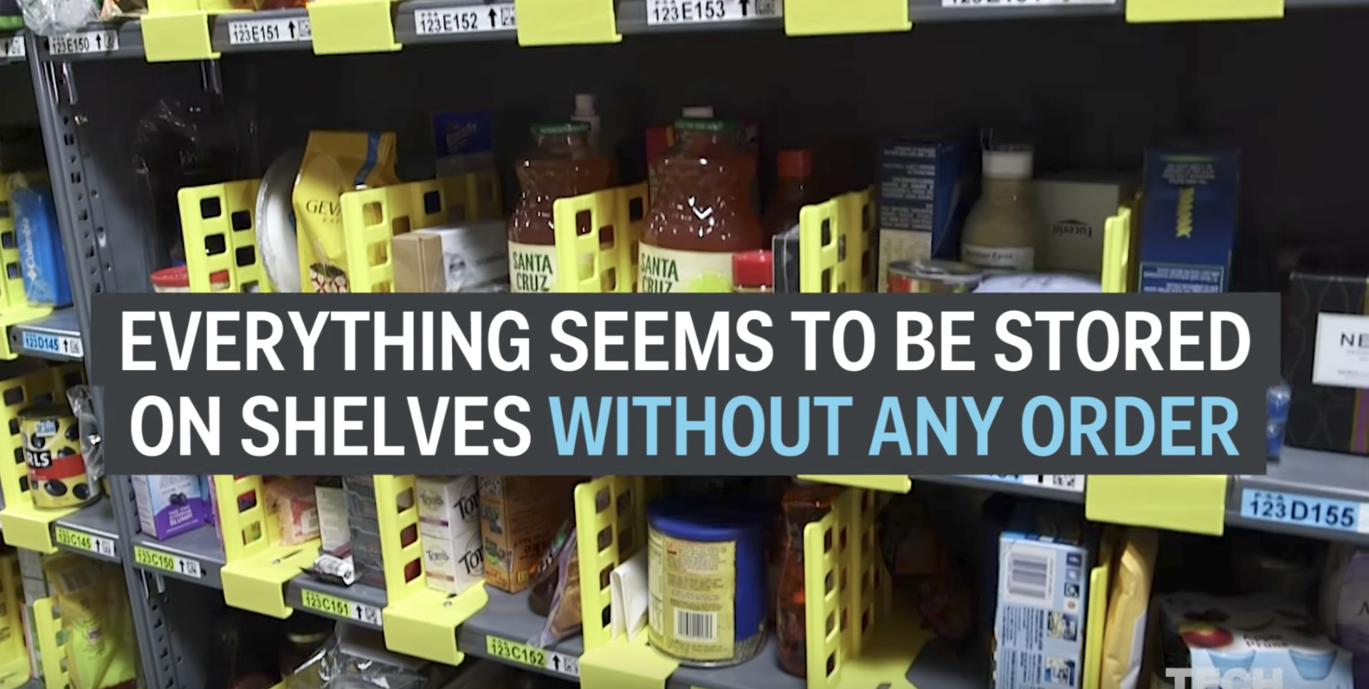
Training Exercise
Amazon Warehouse: Tech Insider https://www.youtube.com/watch?v=5TL80_8ACPc
OpenAPI 3.0 Certification Training Training

Slide 31
Characteristics
Chaotic Storage, fill up available space quickly / evenly.
Every item that is stocked is scanned (barcode) where it is stocked.
Database stores these details and generates fastest route to then pack a shipment.
Workers are provided a location for each item in the order on hand-held device.
OpenAPI 3.0 Certification Training Training

Slide 32
Data
Warehouse identifier
SKU (Barcode)
Location in Warehouse (Barcode)
Quantity
OpenAPI 3.0 Certification Training Training

Slide 33
Info Object

Slide 34
Info Object
Metadata about the API
Who, what, where (contact, license, hostname information)
API Custodian
OpenAPI 3.0 Certification Training Training

Slide 35
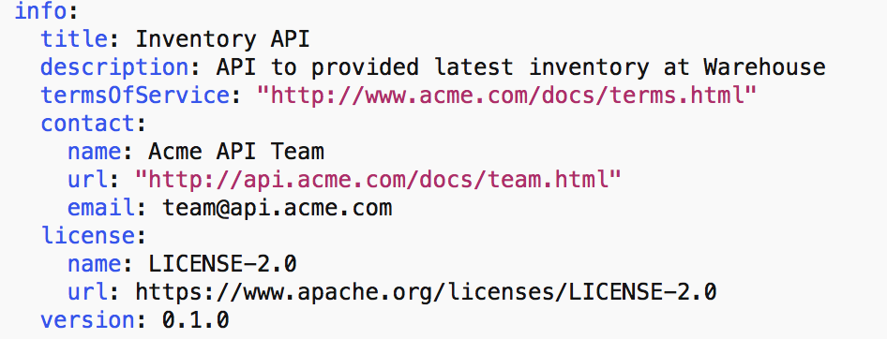
Info Object Example
OpenAPI 3.0 Certification Training Training

Slide 36
Info Object Exercise
OpenAPI 3.0 Certification Training Training

Slide 37
Servers Object

Slide 38
Servers Object
Answers the where question regarding the API
One or more server / hostnames are provided along with additional meta-data such as ports, basePath or other URI variables
https://api.twitter.com/1.1/statuses/user_timeline.json?screen_name=twitterapi&count=2
server url
path
query parameters
OpenAPI 3.0 Certification Training Training

Slide 39
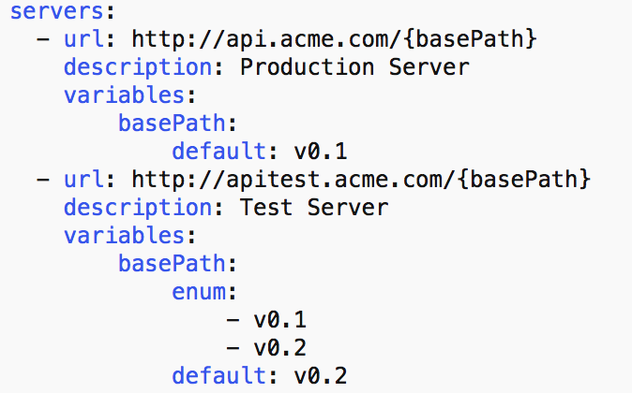
Servers Object Example
OpenAPI 3.0 Certification Training Training

Slide 40
Servers Object Exercise
OpenAPI 3.0 Certification Training Training

Slide 41
Components Object

Slide 42
Components Object
Encompasses schemas, parameters, securitySchemes, requestBodies, responses, headers, examples, links, callbacks
Focuses on reusable elements and the uses reference to component in appropriate section
OpenAPI 3.0 Certification Training Training

Slide 43
Schemas Object

Slide 44
Schemas Object
Using JSON Schema, the Schemas Object identifies the JSON payloads that are received or sent by the API.
Supports different data types including string, number, boolean and further classification such as int32, int64, dateTime.
Optionality, sequencing, descriptions and other meta-data provide a means to clearly define the JSON payload.
OpenAPI 3.0 Certification Training Training

Slide 45
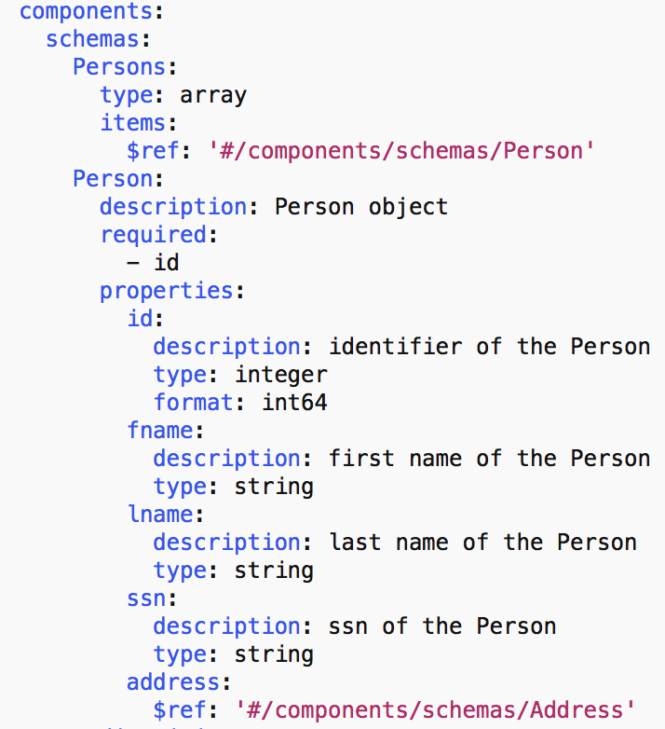
Schemas Object Example
OpenAPI 3.0 Certification Training Training

Slide 46
Data Types
Base Data Types
Data Type | Examples
string | “hello”, c:/file.txt, 2017-11-12
number | Any number
integer | 1,15,22
boolean | True / False
object | JSON Object
array | JSON Array
Note: Mixed types are supported via oneOf, anyOf
OpenAPI 3.0 Certification Training Training

Slide 47
Number with format
How to further articulate specific number / integer types
Data Type | Format | Description
number | -- | Any number
number | float | Floating-point numbers
number | double | Floating-point numbers with double precision
integer | -- | Integer numbers
integer | int32 | Signed 32 bit integers
integer | int64 | Signed 64 bit integers (long type)
OpenAPI 3.0 Certification Training Training

Slide 48
String with format
How to further articulate string formatting
Data Type | Format | Description
string | date | Date notation e.g. 2017-11-12
string | date-time | Date time notation e.g. 2017-11-12T12:00:00Z
string | password | Notify UI to mask
string | byte | Base64 encoded characters
string | binary | Binary data used to describe files.
OpenAPI 3.0 Certification Training Training

Slide 49
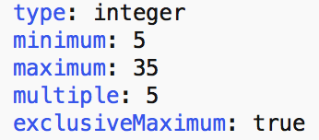
Minimum, Maximum, Multiples
Minimum, Maximum value constraints can be specified
Multiples can be used to constrain a value to a multiple
ExclusiveMinimum and ExclusiveMaximum excludes the value
OpenAPI 3.0 Certification Training Training

Slide 50
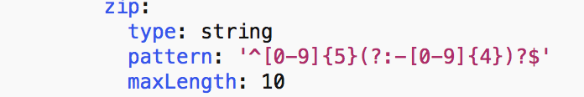
minLength / maxLength / pattern
Constrain a string to have a minimum / maximum length
Apply a pattern to constrain a string
OpenAPI 3.0 Certification Training Training

Slide 51
Paths Object

Slide 52
Paths Object
What the API Provides
URL, MIME Types, Parameters Object, Responses Object
OpenAPI 3.0 Certification Training Training

Slide 53
Determine Interaction
What Verb, Request, Response needs to be identified?
Parameters as input?
RequestBody as input (e.g. JSON)?
OpenAPI 3.0 Certification Training Training

Slide 54
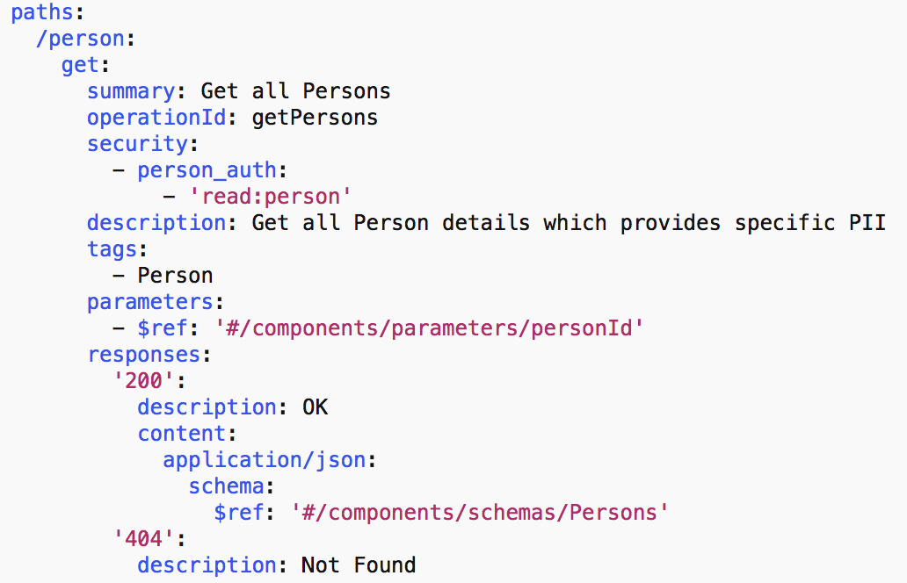
Paths Object Detailed Example
OpenAPI 3.0 Certification Training Training

Slide 55
Paths Object Exercise
OpenAPI 3.0 Certification Training Training

Slide 56
$ref

Slide 57
$ref overview
OpenAPI uses $ref for referencing information within an OAS spec, outside on the file system or at a URL.
$ref: ‘#/components/schemas/elementName
$ref: ‘../person.json#elementName’
$ref: ‘http://path to resource/#elementName’
OpenAPI 3.0 Certification Training Training

Slide 58
Parameters Object

Slide 59
Parameters Object
Identifies where in the request the inbound data will reside
Path, Query, HTTP Header, Cookies
Data can be stored in a several locations (e.g. Path, Query + Header)
Can be defined under Path or at the root level for reuse
OpenAPI 3.0 Certification Training Training

Slide 60
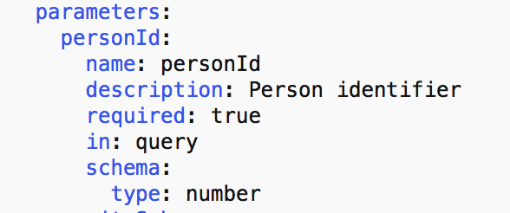
Parameter Object Example
OpenAPI 3.0 Certification Training Training

Slide 61
Parameters Object Exercise
OpenAPI 3.0 Certification Training Training

Slide 62
Media Types

Slide 63
Media Type for Requests/Responses
MIME Type definition for a request or response
Accept: application/json
Content-Type: plain/text
OpenAPI 3.0 Certification Training Training

Slide 64

Media Type Object Example
Application/json
OpenAPI 3.0 Certification Training Training

Slide 65
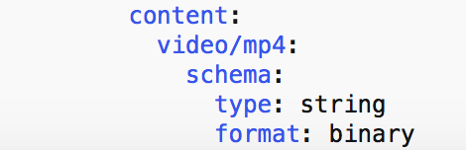
Media Type Object Example
File Upload
OpenAPI 3.0 Certification Training Training

Slide 66
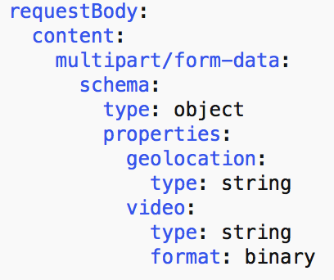
Media Type Object Example
Multipart
OpenAPI 3.0 Certification Training Training

Slide 67
Media Type Object Exercise
OpenAPI 3.0 Certification Training Training

Slide 68
Responses Object

Slide 69
Responses Object
Identifies how the data will be presented back to consumer
MIME Type
Associated Definition Object
OpenAPI 3.0 Certification Training Training

Slide 70
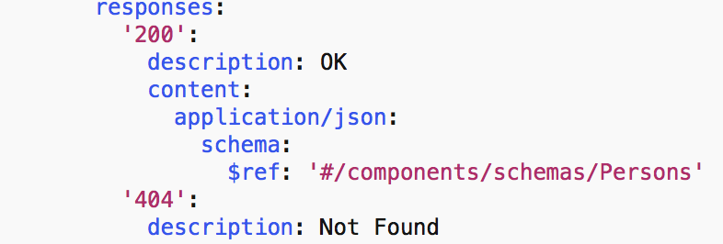
Responses Object Example
OpenAPI 3.0 Certification Training Training

Slide 71
Response Exercise
Create responses for both GET and POST
For GET create 200, 4XX, 5XX
For POST create 201 and 5XX
OpenAPI 3.0 Certification Training Training

Slide 72
Servers Object Exercise
OpenAPI 3.0 Certification Training Training

Slide 73
RequestBody Object

Slide 74
requestBody Object
POST, PUT, PATCH
Distinguishes Payload from Parameters
OpenAPI 3.0 Certification Training Training

Slide 75
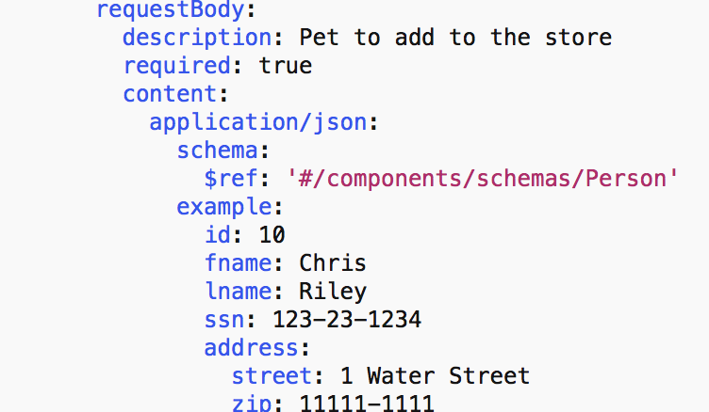
requestBody Example
OpenAPI 3.0 Certification Training Training

Slide 76
requestBody Object Exercise
OpenAPI 3.0 Certification Training Training

Slide 77
Security Object

Slide 78
Security
Supports definition of three different security schemes for an API
HTTP Authentication (RFC 7235)
API Key
OAuth 2.0 (implicit, password, client credentials, authorization code)
OpenID Connect
OpenAPI 3.0 Certification Training Training

Slide 79
securitySchemes / Security Object
Articulate the available authentication and authorization options in securitySchemes within Components.
Apply security by specifying Security object globally or within Path.
OpenAPI 3.0 Certification Training Training

Slide 80
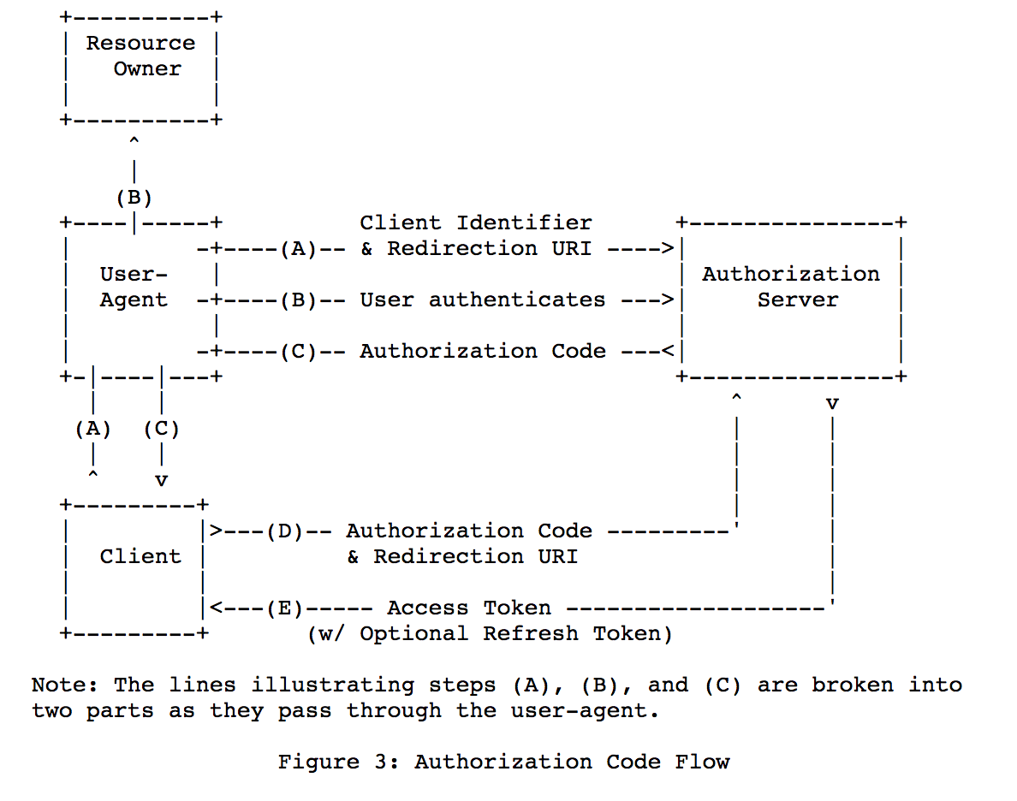
OAuth 2.0
AuthorizationCode Flow
OpenAPI 3.0 Certification Training Training

Slide 81
Authorization
Scopes are supported in OAS for OAuth and OpenID Connect
Specify an array of scope values that are valid
HTTP doesn’t support Scopes so would have an empty array
OpenAPI 3.0 Certification Training Training

Slide 82
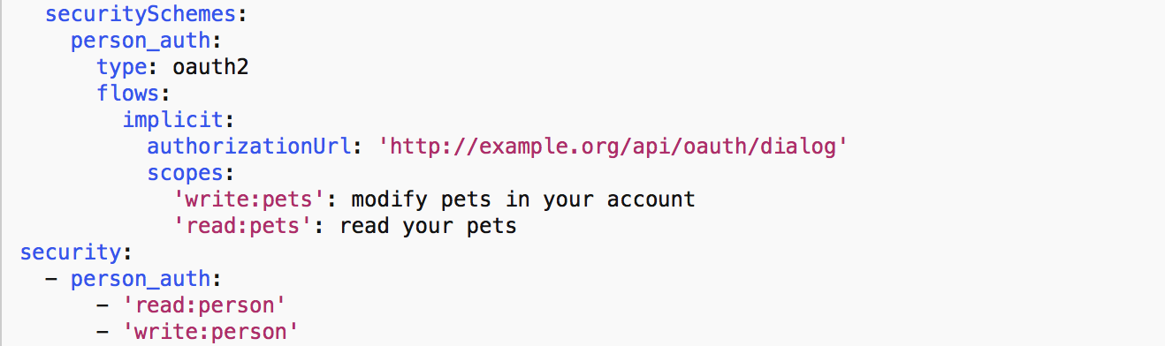
securityScheme Example
OpenAPI 3.0 Certification Training Training

Slide 83
securityScheme Object Exercise
OpenAPI 3.0 Certification Training Training

Slide 84
Training Exercise
Amazon Warehouse: Tech Insider https://www.youtube.com/watch?v=5TL80_8ACPc
OpenAPI 3.0 Certification Training Training

Slide 85
Updated Requirements
External third-party warehouses
Inventory may store both Amazon and Third-party SKUs
Warehouse and External Warehouse queries need to be distinct to route properly
OpenAPI 3.0 Certification Training Training

Slide 86
Advanced Schemas Object

Slide 87
Schemas Combination / Control
Keyword | Description
oneOf | Validates against exactly one subschemas
anyOf | Validates against any of the subschemas
allOf | Validates against all of the subschemas
not | Not Valid against the specified schema
OpenAPI 3.0 Certification Training Training

Slide 88
oneOf Example
Identify one valid object
schemas:
oneOf:
- $ref: ‘#/components/schemas/Student’
- $ref: ‘#/components/schemas/Staff’
{
fname: Chris,
lname: Riley,
personType: Student
}
{
fname: Tim,
lname: Johnson,
personType: Staff
staffType: Adjunct Professor
ssn:555-55-5555
}
or
OpenAPI 3.0 Certification Training Training

Slide 89
anyOf Example
Identify one or more valid objects
schemas:
anyOf:
- $ref: ‘#/components/schemas/Student’
- $ref: ‘#/components/schemas/Staff’
{
fname: Chris,
lname: Riley,
personType: Student
ssn: 444-44-4444
}
{
fname: Tim,
lname: Johnson,
personType: Staff
staffType: Adjunct Professor
ssn:555-55-5555
}
OpenAPI 3.0 Certification Training Training

Slide 90
Difference between oneOf and anyOf Example
one Of = one valid schema….anyOf = one or more valid schema
oneOf
anyOf
Student
Student
or
and
Staff
Staff
OpenAPI 3.0 Certification Training Training

Slide 91
oneOf / anyOf Example
Polymorphism
schemas:
oneOf:
- $ref: ‘#/components/schemas/Student’
- $ref: ‘#/components/schemas/Staff’
{
fname: Chris,
lname: Riley,
personType: Student
}
{
fname: Tim,
lname: Johnson,
personType: Staff
staffType: Adjunct Professor
ssn: 555-55-5555
}
{
fname: Chris,
lname: Riley,
personType: Student
ssn: 444-44-4444
}
OpenAPI 3.0 Certification Training Training

Slide 92
allOf Example
Inheritance / Composition
schemas:
allOf:
- $ref: ‘#/components/schemas/Staff’
properties:
salaryType:
type: string
{
fname: Tim,
lname: Johnson,
personType: Staff
staffType: Adjunct Professor
ssn: 555-55-5555
salaryType: biweekly
}
OpenAPI 3.0 Certification Training Training

Slide 93
not Example
Identify that object doesn’t use certain properties
{
fname: Chris,
lname: Riley,
ssn: 123-33-3333
}
schemas:
Student:
type: object
properties:
ssn:
not:
type: integer
{
fname: Chris,
lname: Riley,
ssn: 123333333
}
OpenAPI 3.0 Certification Training Training

Slide 94
Schemas Object Exercise
OpenAPI 3.0 Certification Training Training

Slide 95
Tags Object

Slide 96
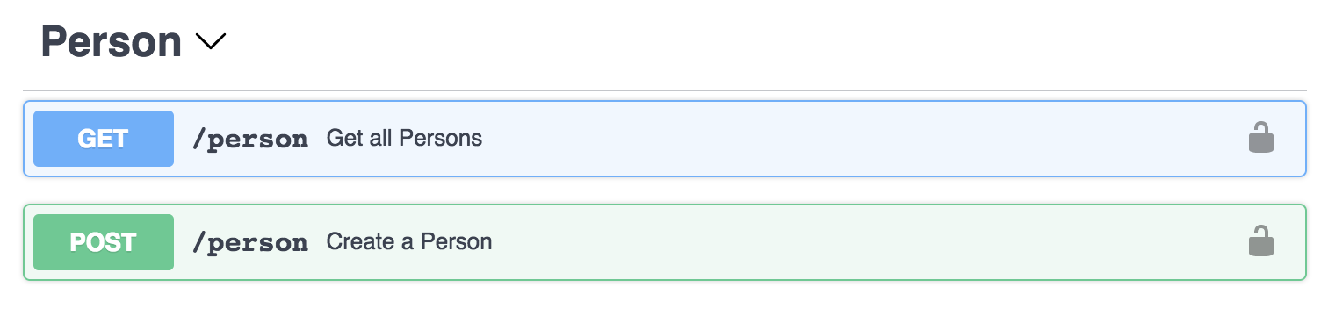
Tags Object
Simple way to group operations within the display.
OpenAPI 3.0 Certification Training Training

Slide 97

Tags Object Example
OpenAPI 3.0 Certification Training Training

Slide 98
Tags Object Exercise
OpenAPI 3.0 Certification Training Training

Slide 99
ExternalDoc Object

Slide 100
externalDoc Object
Provide an external documentation location for detail above and beyond the swagger documentation.
OpenAPI 3.0 Certification Training Training

Slide 101
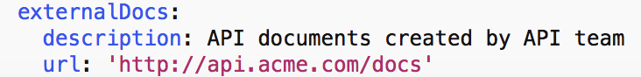
externalDoc Object Example
OpenAPI 3.0 Certification Training Training

Slide 102
Swagger Tooling

Slide 103
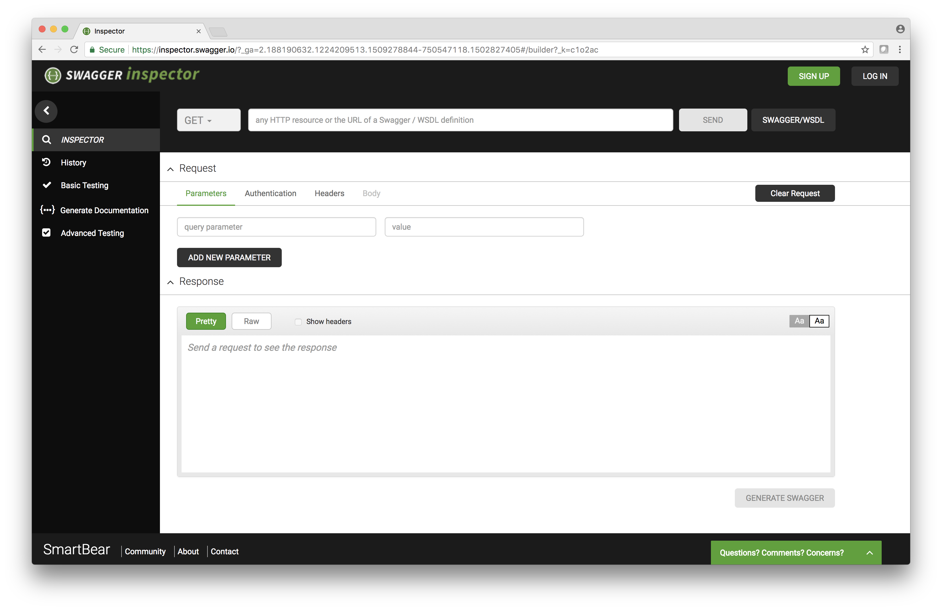
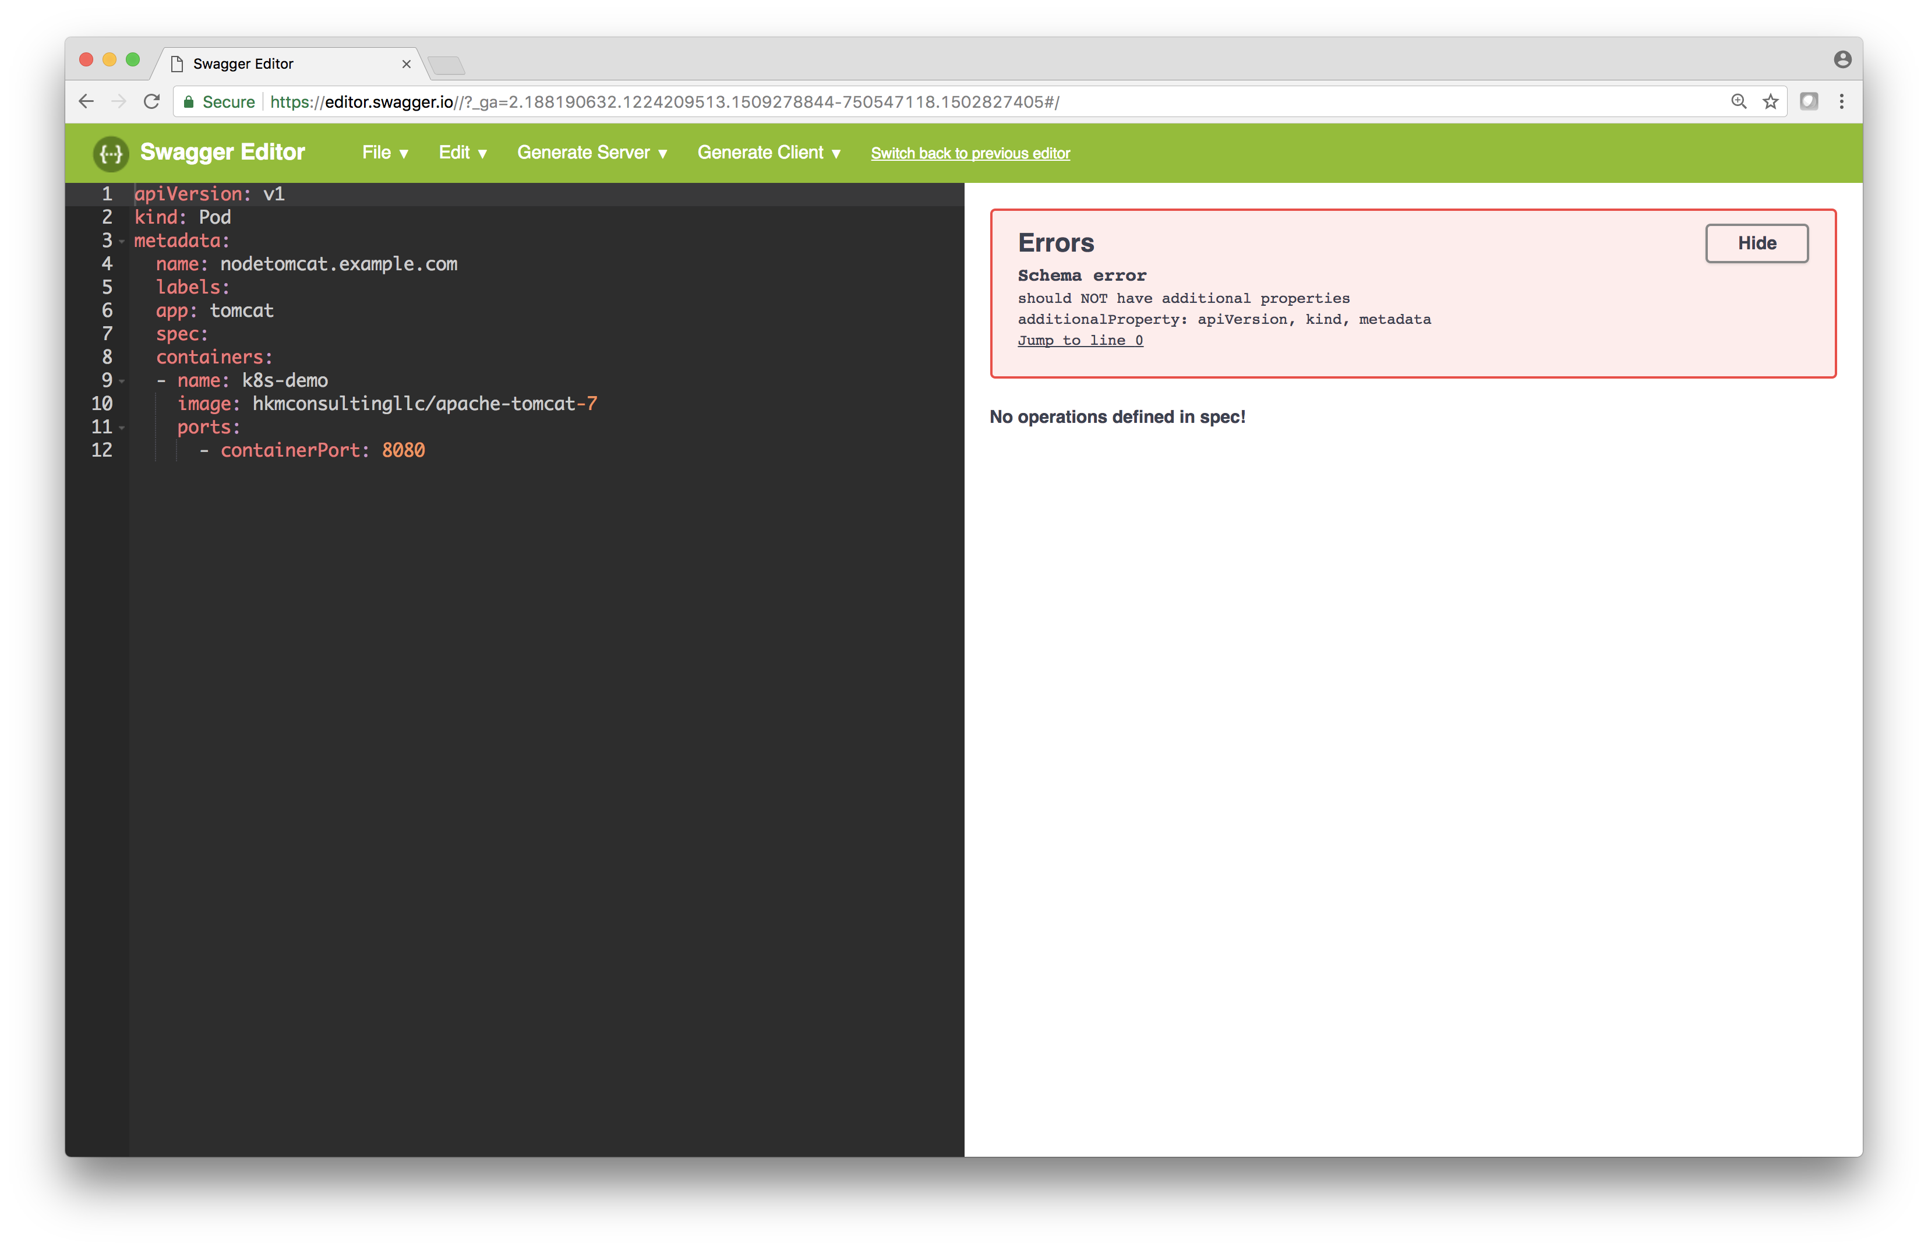
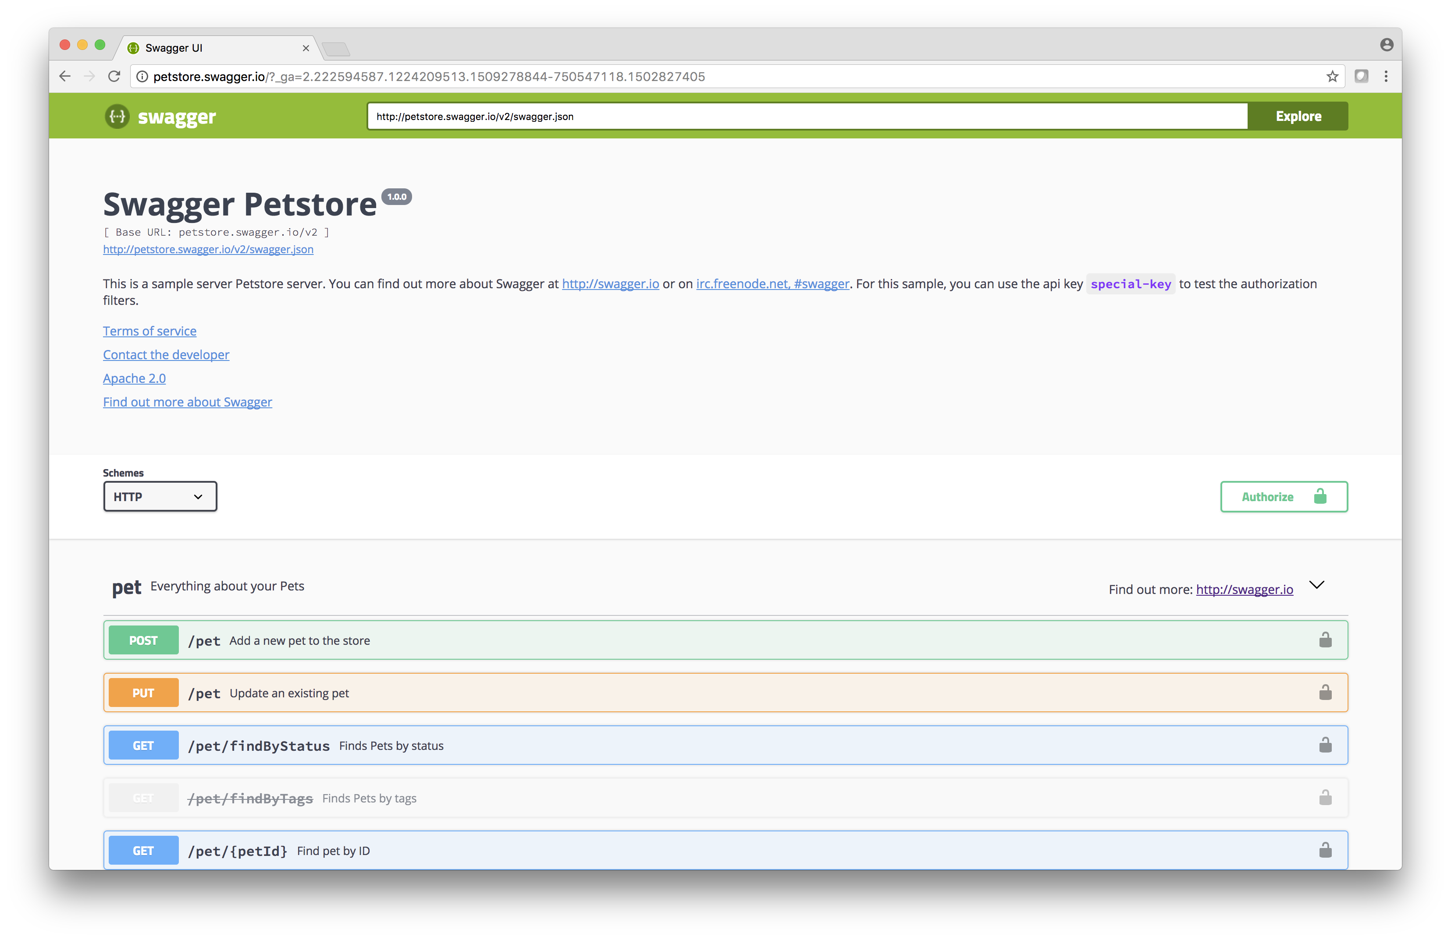
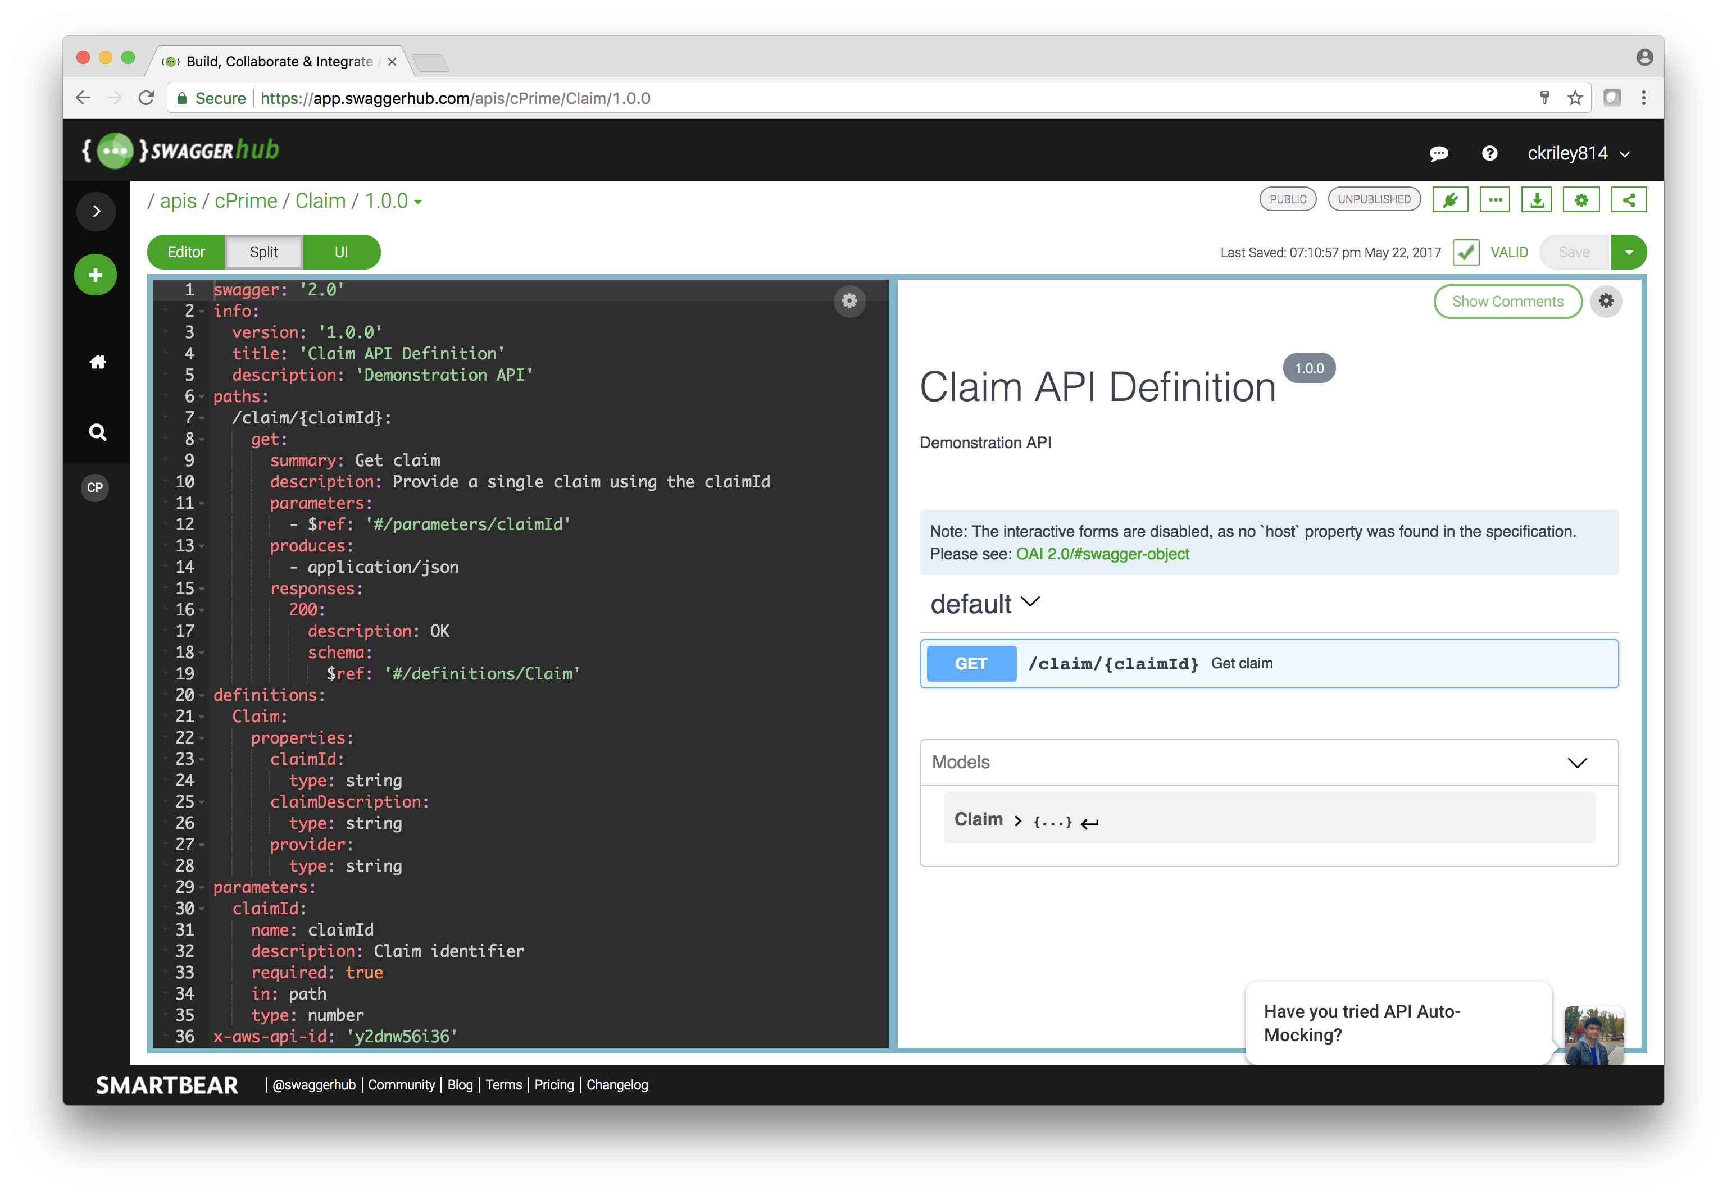
Swagger Tooling
Inspector, Editor, UI, SwaggerHub
OpenAPI 3.0 Certification Training Training

Slide 104
Swagger Tools
Inspector – API Testing
Editor – OAS / Swagger Editor
UI – OAS / Swagger Visualizer
SwaggerHub – OAS/Swagger Collaboration Platform
OpenAPI 3.0 Certification Training Training

Slide 105
Other Swagger Tools
Swagger Codegen - Client Stubs / Server Skeletons
Swagger Core – Java Annotations -> OAS
Third-party
OpenAPI 3.0 Certification Training Training

Slide 106
Tools
Swagger Core – Java annotations to generate Swagger documents
Swagger UI – UI that can render Swagger documents
Swagger Editor – Editor for creating / viewing / editing Swagger documents
Swagger Codegen – Client / Server generation tools
SwaggerHub – SaaS Swagger Collaboration Platform
Smartbear SoapUI – REST API testing leveraging Swagger documents
OpenAPI 3.0 Certification Training Training

Slide 107
Thank you!
Subtitle

